Slide 1
Present simple - questions

Slide 2
Pronouns:
1. I
2. You
3. We
4. They
USE => DO
Examples:
I like hamburgers.
Do I like hamburgers?
They speak Chinese.
Do they speak Chinese?

Slide 3
FOR THESE 4 PRONOUNS:
1. I
2. You
3. We
4. They
TO MAKE A QUESTION, PUT DO AT THE
BEGINNING OF THE SENTENCE.

Slide 4
WHAT HAPPENS WITH THE OTHER 3 PRONOUNS?
Pronouns:
1. He
2. She
3. It
USE => DOES
Examples:
She likes hamburgers.
Does she like hamburgers?
He lives in Ecuador.
Does he live in Ecuador?

Slide 5
WHAT ARE THE RULES?
Put DOES at the beginning of the question.
2. CHANGE THE VERB
to the base form.
The “s” from the verb
is added to D-o-e-s.
EXAMPLES FOR DOES:
My brother has black pen.
Does my brother have black pen?
Her dog bites.
Does her dog bite?
He teaches English.
Does he teach English?

Slide 6
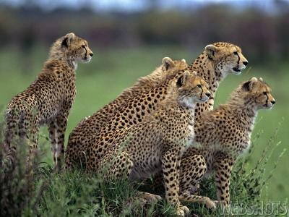
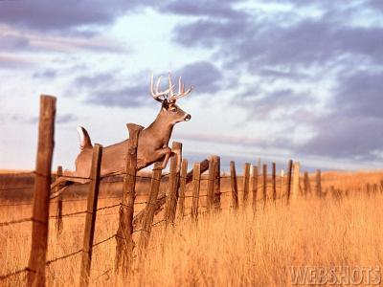
1. Do you see what I see?
2. Do you want to catch him?
3. Does it know we’re watching?
1. Yes, we do.
2. Yes, we do.
3. No, it doesn’t.

Slide 7

Forming WH-Questions with Do, Does
Yes, I do.
Compare:
Do you read every day?
What do you read every day?
Word order:
Wh-question word
do, does,
the subject,
the verb/base form, and the rest of the sentence.
A new novel.

Slide 8
WH question word
Do/ does
Subject
Verb in base form

Slide 9
* Put the suitable answer:
1. _____he buy books?
Do
Does
2. _____you study History?
Do
Does
3. _____Sarah wear jeans?
Do
Does
4. _____Kate wash windows?
Does
Do

Slide 10
5. _____you like holiday?
Do
Does
6. _____she go to school?
Does
Do
7. _____you eat rolls?
Does
Do
8. _____she drink milk shake?
Does
do

